Slide 1




Cybersecurity concerns for the Smart Grid
Our values
Jim Mckenney, MBA, BSE, GPEN, GSNA, Lean
Practice Director, NCC Group
Operational Technology Cyber Engineering
https://www.linkedin.com/in/jimmckenney

Slide 2

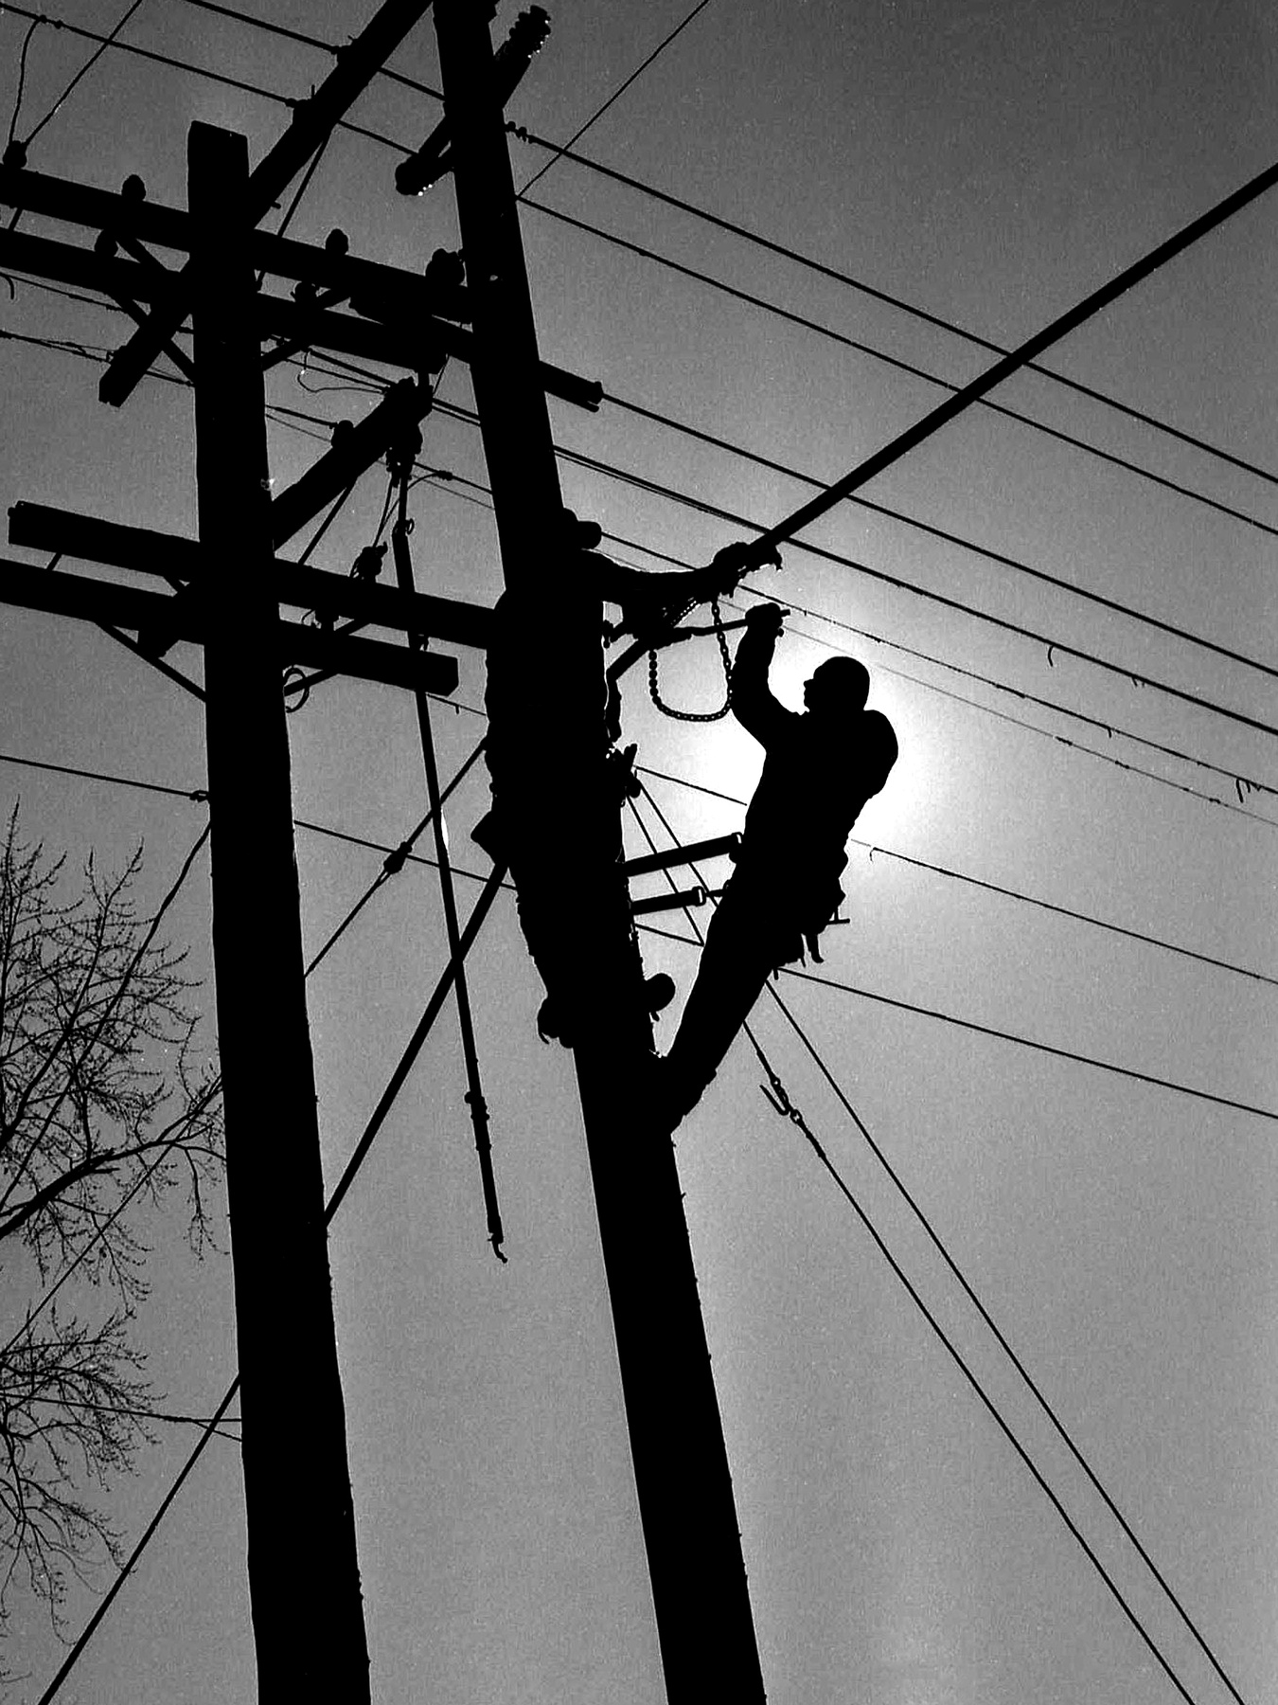

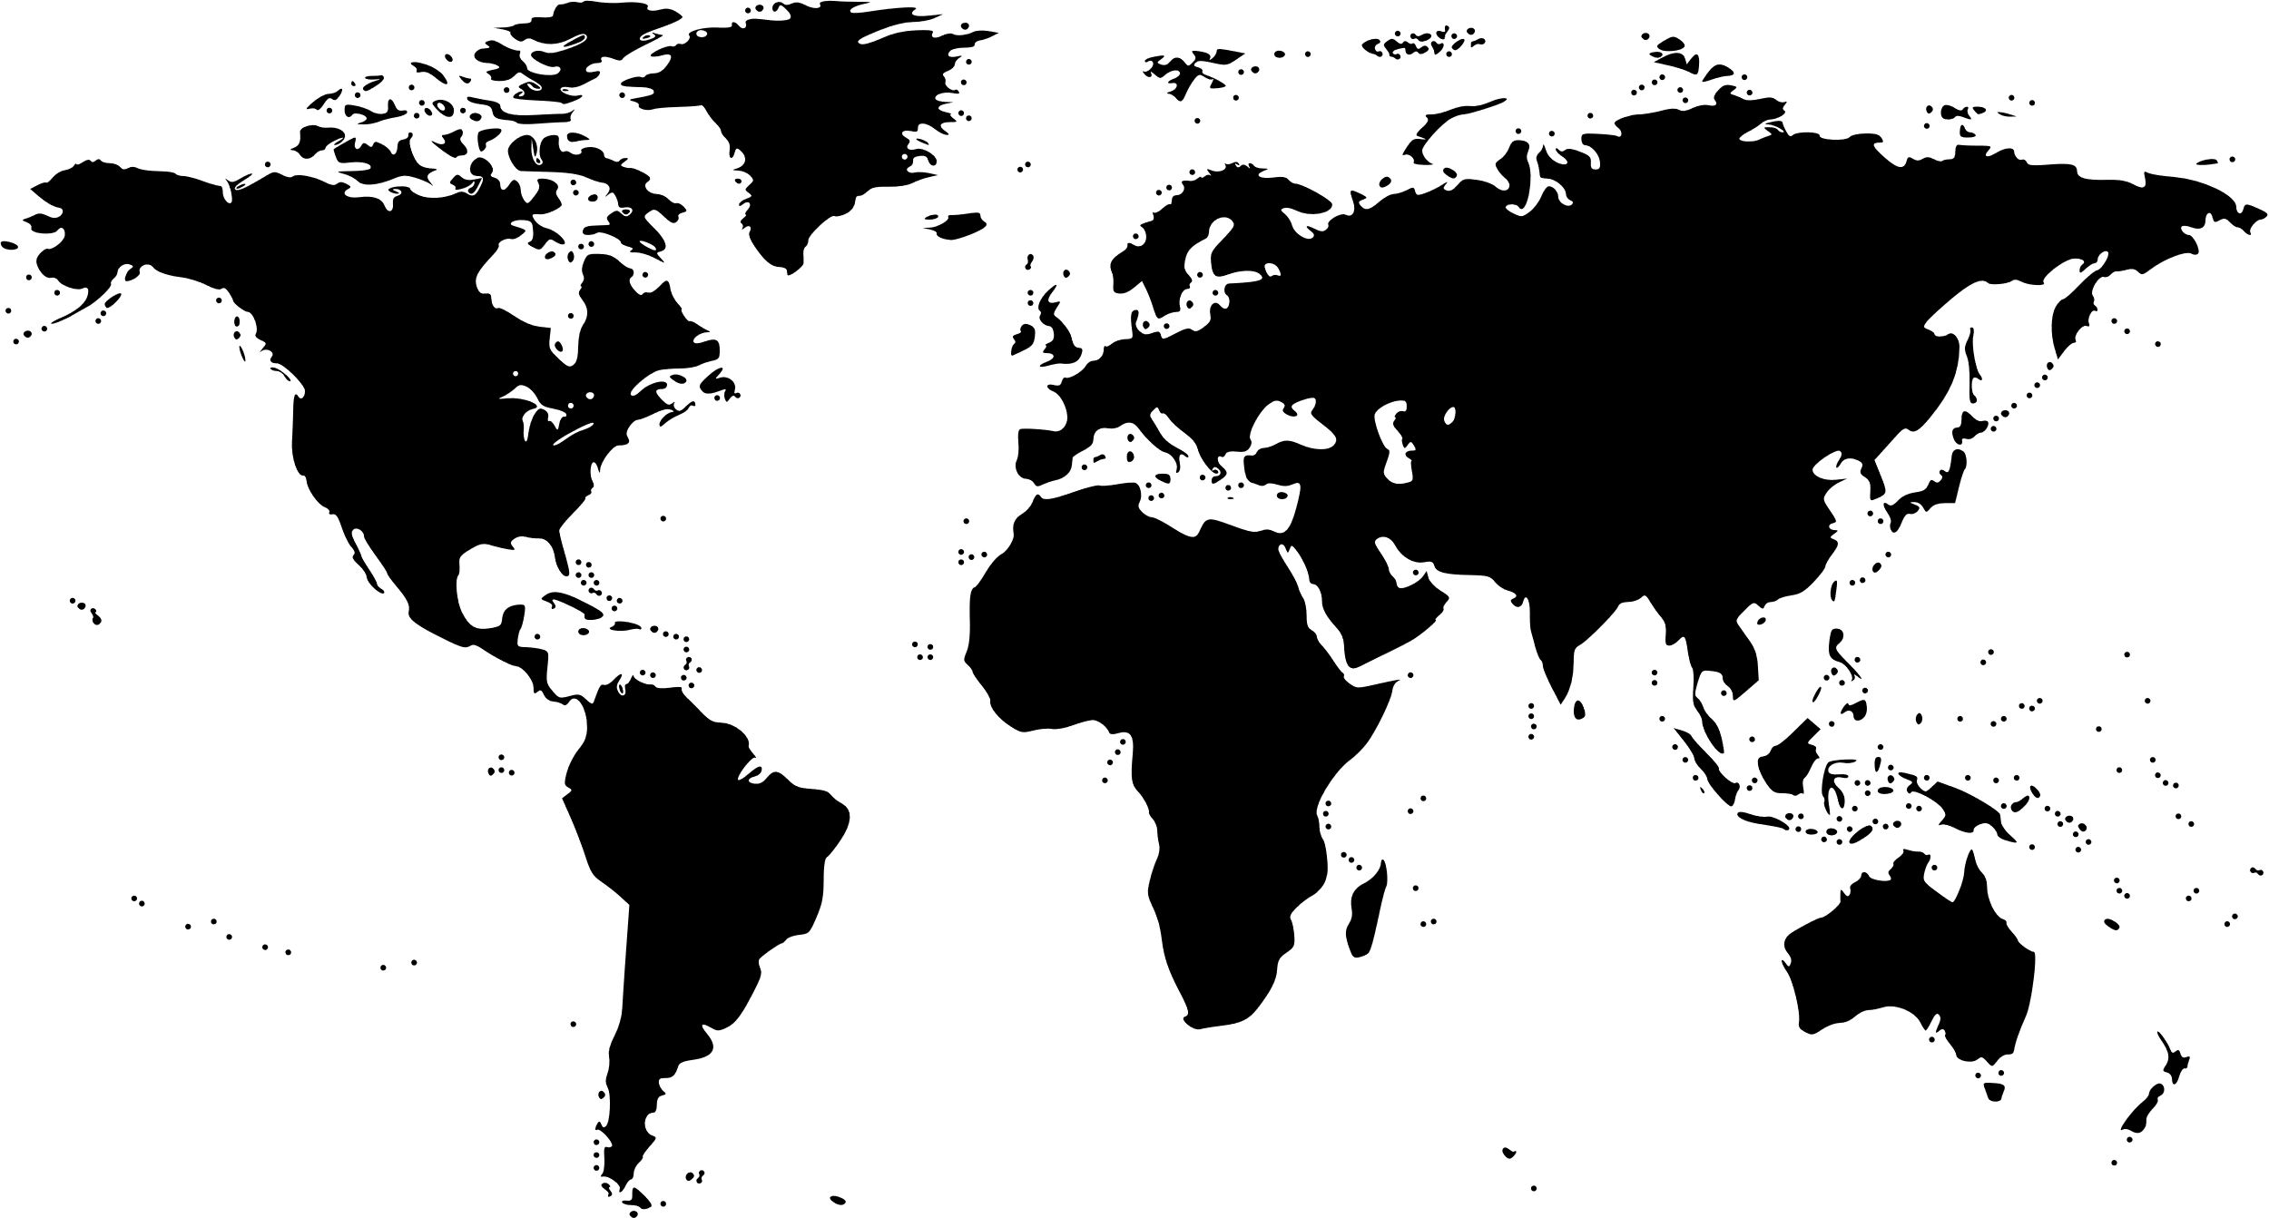

NCC GROUP
OPERATIONAL TECHNOLOGY
CYBER ENGINEERING TEAM
A dedicated engineer-based cybersecurity practice serving industrial facilities and technologies in the Americas, Europe-Middle East Africa, Netherlands & Asia-Pacific.
Our values
Safety is a way of Life
it starts with the customer
People make the difference
Fact based decisions
Right results, Right way
Part of NCC Group
A global consulting firm with exclusive and best in class insight to operational technology threats.
Core Services
Research & Infrastructure Threat Intelligence
Consulting & implementation
Global Managed Services
Facility M&A Due Diligence
Product and Equipment Testing
Technology & Integration Partnerships
NCC Group

Slide 3



NCC GROUP OPERATIONAL TECHNOLOGY CYBER ENGINEERING (OTCE)
KEY SERVICES
What do I have?
What is my risk?
What do I do next?
Due Diligence for production facilities to document “as-is” of networks, systems and equipment; IT, OT & Cloud
Collaborative workshops to assess readiness to incidents such as ransomware in OT
Architecture review to sector frameworks and regulations
Intrusion testing to validate defenses
Forward engineering to define appropriate controls requirements and strategies
Risk Assessment
Threat Modeling
Proof of Concept demonstration
Forensics Readiness Diagnostic
Crisis Management Exercise
Applied global research of realized threats and threat actors, per sector and region
Quick Wins
Priority Action Items
Strategic Recommendations
Target Reference Architecture and Capabilities
Roadmaps and Go-Forward Programs

Slide 4







NCC GROUP OPERATIONAL TECHNOLOGY CYBER ENGINEERING (OTCE)
SMART GRID & DER

Slide 5
NCC GROUP OPERATIONAL TECHNOLOGY CYBER ENGINEERING (OTCE)
2024 INDUSTRY CONCERNS
Utility Cyber Security Forum Conference, 19-21 March Chicago
The current status of nation-state level APTs for the energy industry
Defense-in-depth networking strategies
Dealing with various protocols in the network (utility protocols, manufacturing protocols, etc.)
Data protection
Architecting a network security solution to address cyber threats
Creating a culture of cyber compliance within a utility
Holistic approaches to achieving greater network visibility
Integrating natural gas, oil and pipeline industry as it relates to smart grid, SCADA & control systems security
Addressing the IT / OT divide
Protecting substations and distribution and transmission infrastructure from cyber attacks
Cyber security for operational technologies and smart systems
Ensuring grid SCADA and PLC grid control networks cyber security
What works, what doesn't, and what to put in place
Steps for recovering from an industrial control system cyber breach
Best practices in reducing human sources of vulnerability
Key points to consider include:
Threats in the energy industry
Incidents and warnings reported by CISA
Predictive models indicating potential chain reactions
IT & OT integration
Incorporating Distributed Energy Resources
Ensuring cybersecurity for Operational Technology and Smart Systems
Concerns about the supply chain
Relating to power applications and equipment
Resource limitations
Challenges with personnel, tools, and partnerships
Comprehensive Cybersecurity
Understanding asset visibility
Addressing equipment vulnerabilities
Securing communication and Distributed Energy Resources endpoints
Implementing effective incident response

Slide 6

NCC GROUP OPERATIONAL TECHNOLOGY CYBER ENGINEERING (OTCE)
Advanced Metering Infrastructure
AMI Meters, communication networks and meter data management software
Itron Lands-Gyr Aclara Honeywell
Protection, control, measurement and automation via relays, meters, sensors and substation automation devices
ABB Siemens GE Schneider Electric
Intelligence Electronic Devices
SMART GRID TECHNOLOGIES
Supervisory Control & Data Acquisition Systems (SCADA)
SCADA Solutions for power utilities and renewable energy, power transmission and distribution monitoring
Schneider Electric ABB OSI Siemens
Energy Management Systems (EMS)
Advanced EMS for control centers outage management and automation
GE Grid OSI Siemens ABB

Slide 7




NCC GROUP OPERATIONAL TECHNOLOGY CYBER ENGINEERING (OTCE)
REQUIRED CAPABILITIES
Real time visibility
Remote Control & Automation
Integration of DERS with Grid Management
Advanced SCADA systems should provide granular, real-time data on the status, output, and health of DERs, such as solar panels, wind turbines, and battery storage systems.
This data can be collected through a network of smart meters, sensors, and IoT devices, enabling operators to monitor DER performance at both the individual and aggregate levels.
SCADA systems should enable operators to remotely control and optimize the operation of DERs based on factors such as energy demand, weather conditions, and grid stability.
This can be achieved through the use of advanced algorithms, machine learning, and artificial intelligence techniques that can automatically adjust DER settings and dispatch resources as needed.
Advanced SCADA systems should seamlessly integrate with other grid management systems, such as energy management systems (EMS), distribution management systems (DMS), and outage management systems (OMS).
This integration enables a holistic view of the grid and allows for coordinated control and optimization of DERs in conjunction with other grid assets and operations.
Copper Valley Electric Association in Alaska uses a SCADA system to monitor the performance of its 1.8 MW solar array in real-time, allowing operators to quickly detect and respond to any issues.
Kauai Island Utility Cooperative in Hawaii uses a SCADA system with automated controls to manage a 13 MW solar array and 52 MWh battery storage system, ensuring optimal performance and grid integration.
Western Farmers Electric Cooperative in Oklahoma has implemented an integrated SCADA and DMS system to manage its growing portfolio of DERs, including wind and solar power, while ensuring reliable and efficient grid operations

Slide 8

NCC GROUP OPERATIONAL TECHNOLOGY CYBER ENGINEERING (OTCE)
Understanding our Environment & Ecosystem
What assets do I have?
How do they change over time?
Who has access?
What will my network look like in 3 years?
What is the risk to operations?
How do I prioritize?
How do I isolate external data communications?
What tooling and expertise do I have that works in OT?
KEY CHALLENGES
Managing vulnerabilities
Do we already have issues?
What have others done?
What do we do about it?
Do I have resources and processes to respond to cyber incidents?
Detecting Threats

Slide 9





NCC GROUP OPERATIONAL TECHNOLOGY CYBER ENGINEERING (OTCE)
KEY PATTERNS
Defense-in-Depth and Segmentation
A multi-layered defense-in-depth approach is recommended for securing the complex IT and OT environments in the energy sector. This includes implementing network segmentation, firewalls, intrusion detection/prevention systems, and other security controls to protect critical systems and limit the potential impact of cyber threats.
Continuous Monitoring & Incident Response
Continuous monitoring of IT and OT systems, along with robust incident response capabilities, is essential for detecting and responding to cyber threats in a timely manner[1][5][15]. This includes deploying security information and event management (SIEM) solutions, conducting regular vulnerability assessments, and maintaining well-defined incident response plans.
Privileged Access Management & Secure Remote Access
PAM systems are crucial for controlling and monitoring privileged access to critical systems and infrastructure in the energy sector. They help enforce least privilege principles, manage shared accounts, and provide detailed auditing and reporting capabilities. PAM solutions can secure remote access for vendors, contractors, and employees to operational technology (OT) systems like SCADA and DCS.
NCC Group

Slide 10
NCC GROUP OPERATIONAL TECHNOLOGY CYBER ENGINEERING (OTCE)
THREATS TO ENERGY

Slide 11




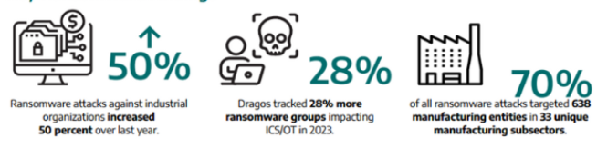

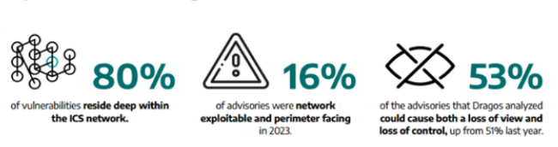
NCC GROUP OPERATIONAL TECHNOLOGY CYBER ENGINEERING (OTCE)
KEY TRENDS IN OT/ICS 2024
RANSOMWARE
VULNERABILITIES

Slide 12



NCC GROUP OPERATIONAL TECHNOLOGY CYBER ENGINEERING (OTCE)
Pwn2Own Automotive 2024
Goals
Provide an avenue to encourage automotive research. We want to offer a place where researchers can submit and be financially rewarded for reports targeting various products and platforms.
Incentivize vendors to participate in the security research community. We want to connect our global community of security researchers with automotive manufacturers to help improve their security and resiliency.
Bring a focus to the sub-components of a vehicle. Rather than looking at the vehicle as a monolithic unit, we want to bring attention to the multiple complex systems that comprise a modern automobile.
Outcome
On the first day, researchers discovered vulnerabilities in Telsa’s modem, Sony’s infotainment systems, and Alpine car audio players, collectively earning $722,500 in awards for identifying three bug collisions and 24 zero-day exploits
MORE INFORMATION
NCC Group
The NCC Group EDG team won $170,000 for exploiting zero day bugs to hack Pioneer DMH-WT7600NEX and Phoenix Contact CHARX SEC-3100 EV Chargers, Chargepoint Home Flex and Sony XAV-AX5500.

Slide 13








NCC GROUP OPERATIONAL TECHNOLOGY CYBER ENGINEERING (OTCE)
WARDIERE INC.
THREAT MODEL OF EV TO GRID
Electric Vehicle
User
Mobility Provder
OEM (Hardware/Software)
Charging Station
Operator
Distribution System Operator (DSO)
Other Customers
Temporary Data Exchange
Attack Vector
Data Exchange
Electricity

Slide 14










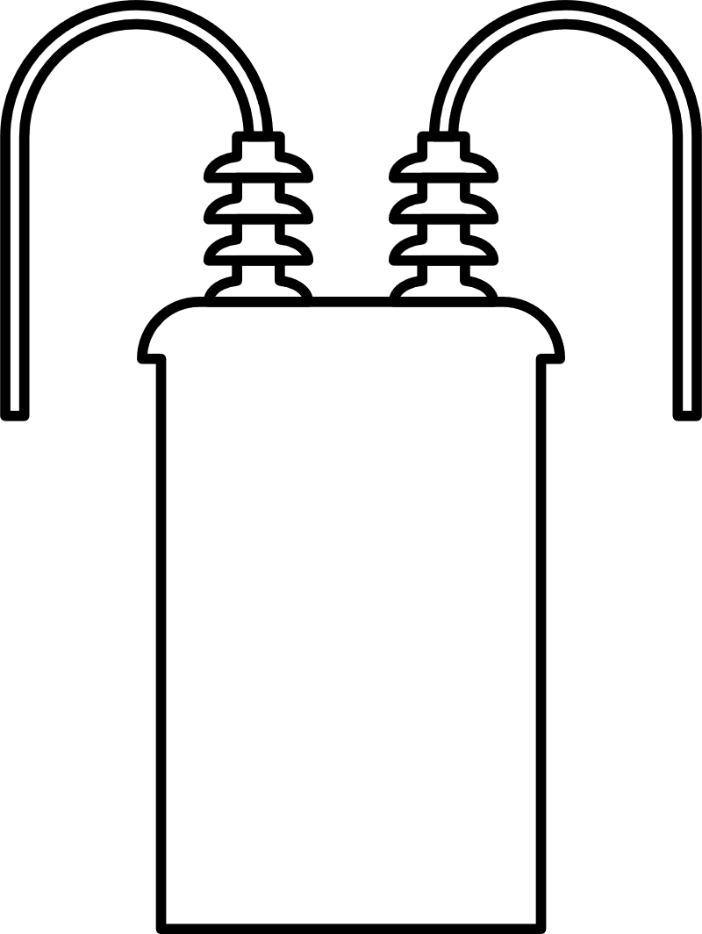

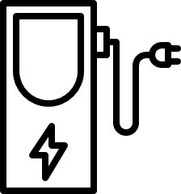
NCC GROUP OPERATIONAL TECHNOLOGY CYBER ENGINEERING (OTCE)
GRID POWER AND DATA FLOW
Demand Response Aggregator
Signal Flow
Power Flow
SCADA
Advanced Metering Infrastructure
(AMS)
Advanced Metering Infrastructure
(AMS)
Advanced Metering Infrastructure
(AMS)
IED/PLC
RTU/PMU
IED/PLC
RTU/PMU
IED/PLC
RTU/PMU
Cyber Layer
Physical Layer
Generation Facility
Transmission Facility
Distribution Facility
Wind
DER & Storage
Generation Substation
Transmission Line
Transmission Substation
Distribution Feeder
DistributionSubstation
Distributed Energy Res.
Commercial & Indus. Prosumer
Residential Prosumer Facility

Slide 15

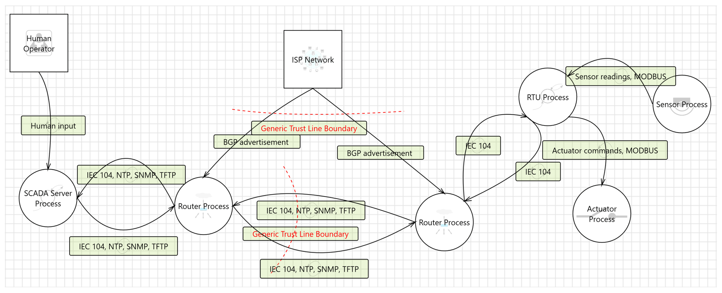
NCC GROUP OPERATIONAL TECHNOLOGY CYBER ENGINEERING (OTCE)
TRADITIONAL POWER THREAT MODEL
Traditional Threat Model
Traditional electricity distribution systems were relatively isolated and had a limited attack surface for cyber threats. These systems relied heavily on proprietary hardware and software, with minimal connectivity to external networks or the internet. The operational technology (OT) components, such as supervisory control and data acquisition (SCADA) systems and remote terminal units (RTUs), were typically air-gapped from corporate IT networks, reducing the potential entry points for cyber attacks. Additionally, the centralized generation and distribution model meant that the number of access points and interconnected devices was relatively small, further limiting the attack surface. While not immune to cyber threats, the inherent isolation and lack of interconnectivity made it more challenging for adversaries to gain unauthorized access or disrupt operations remotely.

Slide 16
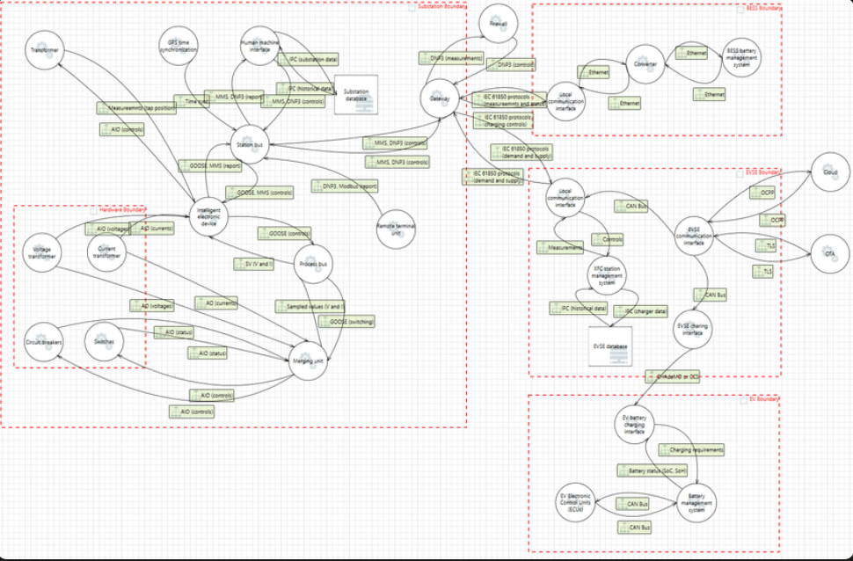
NCC GROUP OPERATIONAL TECHNOLOGY CYBER ENGINEERING (OTCE)
SMART GRID THREAT MODEL
Smart Grid & DER Threat Model
The advent of smart grids and the integration of distributed energy resources (DERs) have significantly expanded the attack surface for cyber threats. Smart grids rely on a complex ecosystem of interconnected devices, communication networks, and control systems, introducing numerous potential entry points for adversaries. DERs, such as solar panels, wind turbines, and energy storage systems, are often connected to the grid through internet-enabled controllers and communication links, increasing the risk of remote exploitation. Furthermore, the supply chain for smart grid components, including hardware and software from various vendors, introduces additional vulnerabilities that could be exploited through compromised equipment or malicious code. The bidirectional flow of electricity and data in smart grids, coupled with the distributed nature of DERs, creates a more complex and dynamic environment, making it challenging to implement comprehensive security measures and monitor for potential threats across the entire system.
MORE INFORMATION

Slide 17
NCC GROUP OPERATIONAL TECHNOLOGY CYBER ENGINEERING (OTCE)
RECENT ACTUALS
Ukraine Power Grid 2019
Colonial Pipeline Ransomware Attack (2021)
A coordinated cyber attack caused blackouts affecting around 230,000 people in Ukraine. Russian hackers used malware like BlackEnergy to gain access to industrial control systems of power distribution companies and remotely switch off substations.
A ransomware attack by DarkSide forced Colonial Pipeline to shut down its major fuel pipeline system, leading to widespread fuel shortages across the U.S. East Coast.
CYBER ATTACKS ON POWER
Cyberattack on British Water Company (2022)
European Transmission System Operators (ENTSO-E) (2020)
A cyberattack hit a British water company supplying 1.6 million customers, though the full impact remains unclear.
Hackers breached the network used by ENTSO-E for coordinating the European power grid, potentially enabling disruptions across multiple countries.
Cyberattacks on Danish Energy Companies (2023)
Ransomware Attacks on Brazilian Utilities (2021)
Over 20 energy companies in Denmark experienced cyberattacks that breached firewalls and accessed some industrial control systems, forcing temporary disconnections
The Copel and Electrobas utilities in Brazil were hit by ransomware attacks, disrupting operations and billing systems.

Slide 18



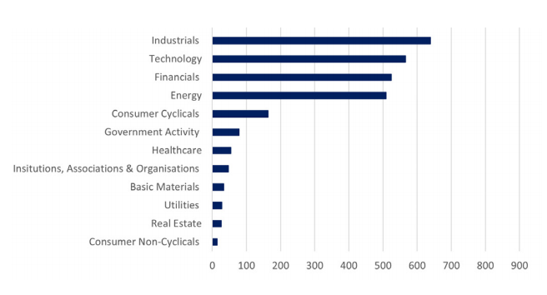
NCC GROUP OPERATIONAL TECHNOLOGY CYBER ENGINEERING (OTCE)
KEY ACTOR: SANDWORM
Sandworm: Industroyer2 and CaddyWiper Attacks
Early on in the war, Russia employed a renewed version of the ICS-capable malware Industroyer, dubbed Industroyer2, to target a Ukrainian energy company. These destructive attacks were scheduled for the 08/04/22, and were reported to have been planned for at least two weeks prior. Notably, the malware’s close association to Industroyer, exploited by Sandworm in the Ukrainian 2016 attacks, demonstrates how threat actors can develop existing capabilities to new environments and objectives. As such, remaining astute to pre-existing malware exploited to target OT environments in the sector should form a key part of organisational defence measures.
NCC SOC Incidents by Sector
Sandworm: Ukrainian Power Outages using Living off the Land Techniques (LoTL)
The rise in targeting OT systems in Ukraine in October 2022 led to power outages and missile strikes on vital infrastructure. Sandworm used LoTL techniques and CaddyWiper to focus on Energy infrastructure. Initial access was through the IT network, enabling breach of the OT environment. The attack resulted in an unscheduled power outage and disruptions. Russia's capabilities in targeting OT systems were highlighted, emphasizing disruption of critical infrastructure. There is a global threat to critical infrastructure, and organizations are advised to follow recommendations in the Mandiant report.

Slide 19
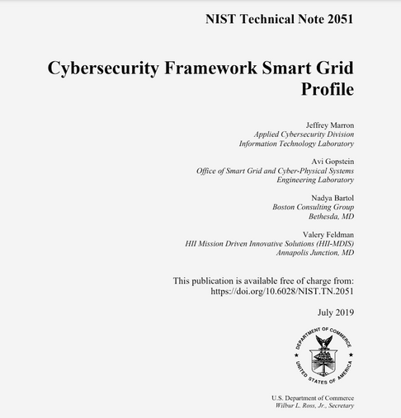

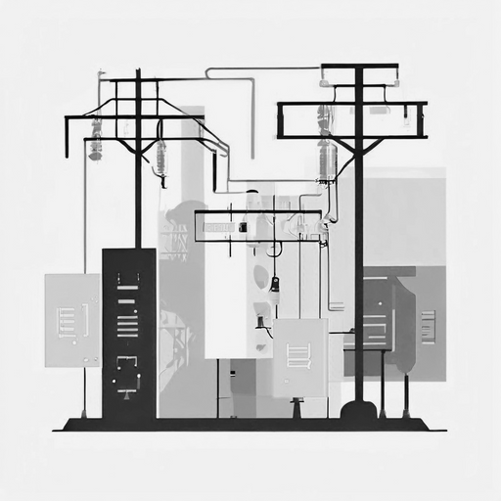
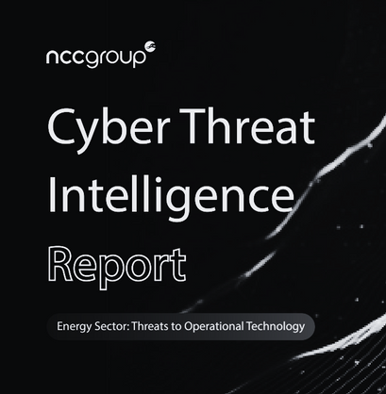
NCC GROUP OPERATIONAL TECHNOLOGY CYBER ENGINEERING (OTCE)
GO FORWARD
NIST IR 7628
NERC CIP
IEC62443
Industry Threat Reports and Feeds
This comprehensive framework developed by the National Institute of Standards and Technology (NIST) provides guidelines, standards, and best practices for ensuring the cybersecurity and interoperability of smart grid systems. It covers risk management, security requirements, and privacy considerations across various smart grid domains and interfaces
The North American Electric Reliability Corporation (NERC) CIP standards are mandatory cybersecurity regulations for the bulk electric system in North America. These standards, approved by the Federal Energy Regulatory Commission (FERC), establish requirements for identifying and protecting critical cyber assets, personnel training, incident reporting, and recovery plan
The IEC 62443 standards provide a comprehensive framework for managing cybersecurity risks in industrial automation and control systems (IACS) used in the electricity sector. They adopt a risk-based approach, defense-in-depth strategy, and lifecycle approach to enhance cybersecurity. The standards define vendor requirements, promote interoperability, and provide guidance on incident response. Aligning with IEC 62443 can help utilities demonstrate compliance and ensure operational continuity.
Public annual threat reports are invaluable to organizations, providing insights into evolving cyber threats and latest adversary techniques. This knowledge helps organizations strengthen their defenses and encourages collaboration and best practice sharing in cybersecurity.
Public streaming and monthly threat feeds provide information on current cyber threats, enhancing an organization's situational awareness.

Slide 20


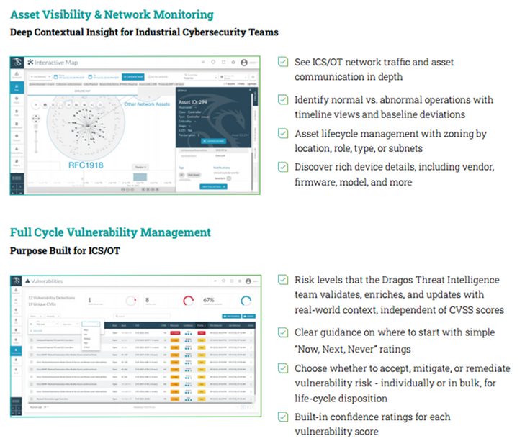
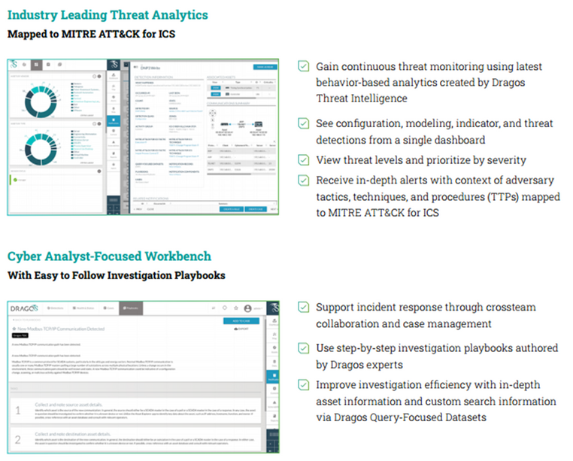
Community Defense Program
For Electric Cooperatives
NCC Group and Dragos have teamed up to help protect Critical Infrastructure by providing local industry leading asset, vulnerability and threat detection capabilities and incident response retainers services. Benefits include:
Free Platform
Free Dragos Platform, including Sensors and SiteStore
Neighborhood Keeper membership for collective defense
Threat Hunting services
Dragos OT-CERT membership
Dragos Academy access
Software and Knowledge
Pack update
Local Cooperative Installation & Use
Platform installation tuning and testing
Incident Response integration
Incident Response
Access to NCC and Dragos IT & OT Rapid Response Retainer Services

Slide 21

NCC GROUP OPERATIONAL TECHNOLOGY CYBER ENGINEERING (OTCE)
THANK YOU
Cybersecurity concerns for the Smart Grid
Jim Mckenney, MBA, BSE, GPEN, GSNA, Lean
Practice Director, NCC Group
Operational Technology Cyber Engineering
https://www.linkedin.com/in/jimmckenney
NCC Group

